Slide 1
HTML- FORM
Athoug Alsoughayer

Slide 2
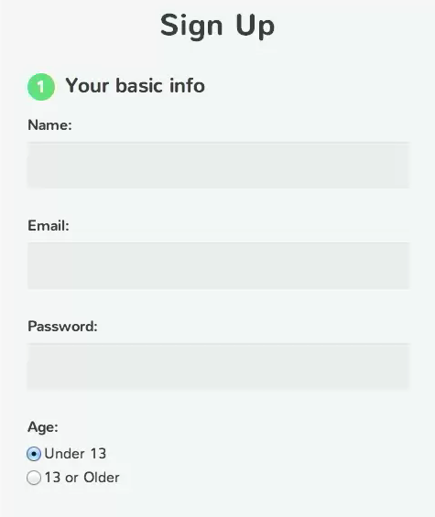
Accepting input from the user means creating a web form, which is typically composed of form controls like text fields, radio buttons, checkboxes, select menus, and more.

Slide 3
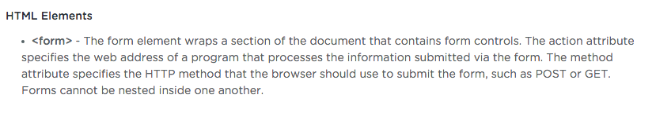
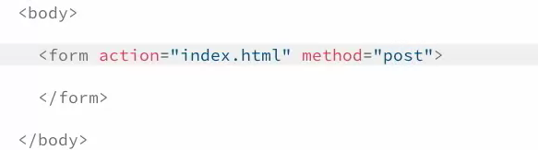
The Form Element
The first element we’ll learn about is the form element. This special element wraps all the other elements that go inside of our form.

Slide 4
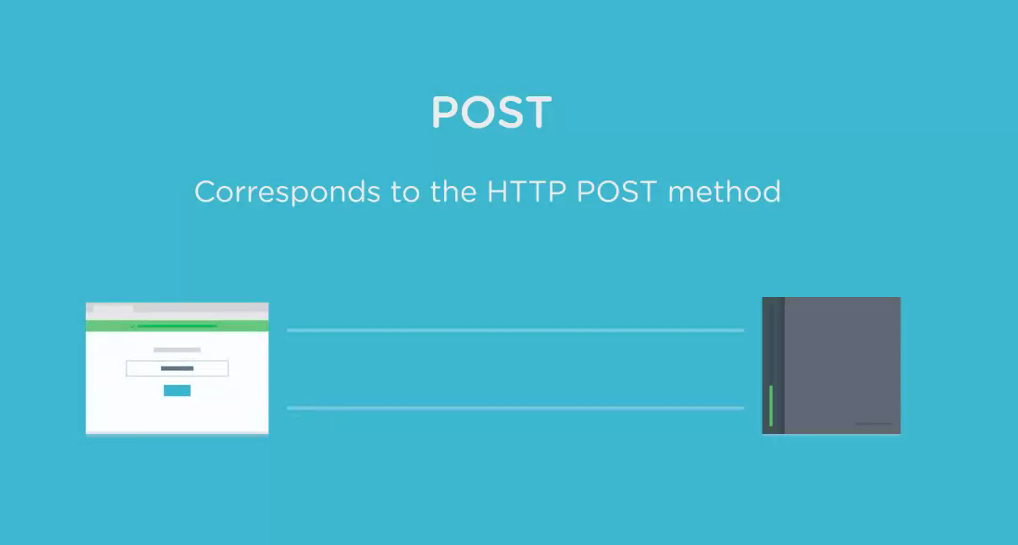

Slide 5
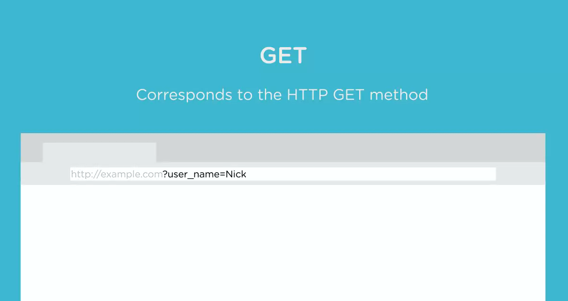

Slide 6
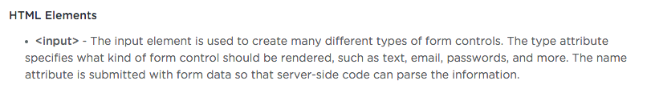
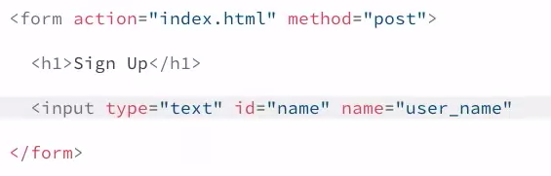
The Input Element
The input element is the most commonly used form element. We can use the input element to make text fields, and much more.

Slide 7
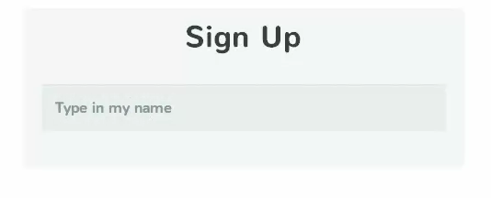

Slide 8
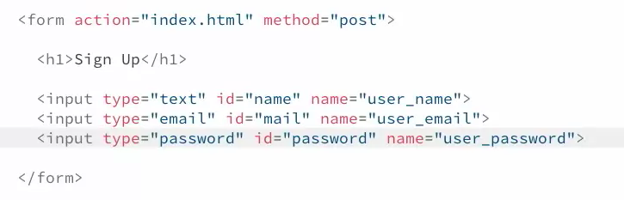
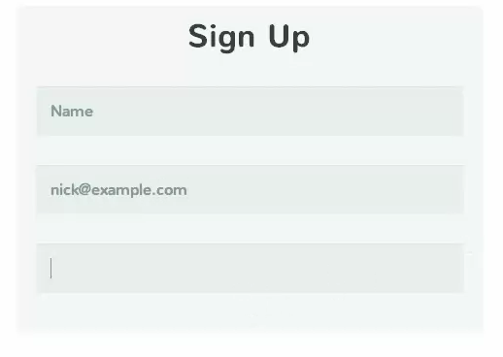

Slide 9
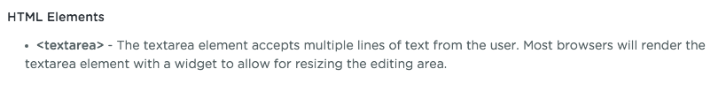
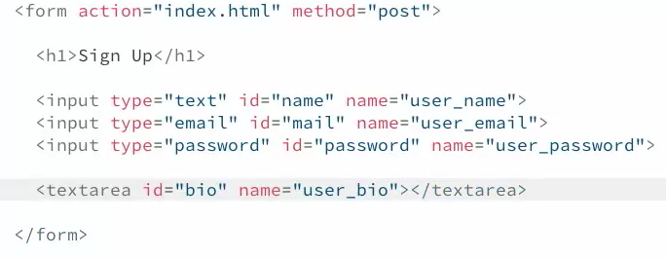
The Textarea Element
Sometimes a single line of text isn’t enough and a simple input element won’t work. For example, maybe you have a contact form and you need a place for people to type a message. In those cases, it’s best to use a textarea.

Slide 10
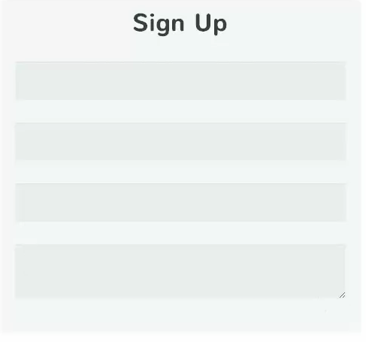
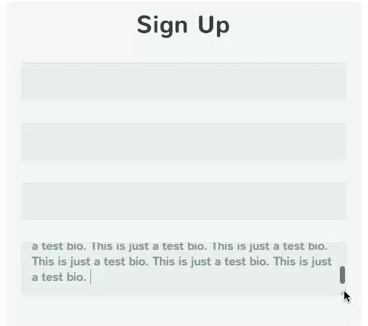

Slide 11
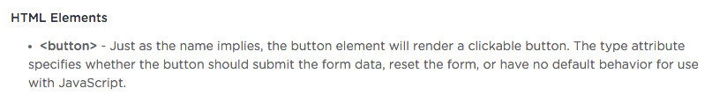
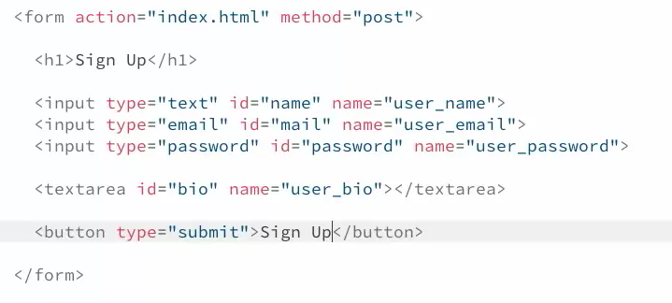
The Button Element
A form is not complete without a submit button. Once a user has finished filling out a form, they should be able to click a button that sends their data to the web server.

Slide 12
